Slide 1
JIRA Optum Claims Provider and Support Operations
Chalsea Carroll-Lueschow
Senior Trainer, Optum Automation
Automation, Re-Imagination, and Transformation

Slide 2
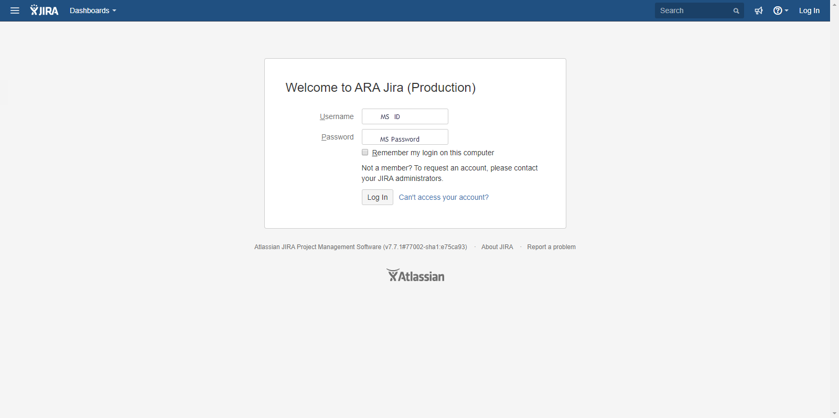
JIRA Log-in Page
https://arajira.optum.com/jira/login.jsp
Notes:
Say: This is the log-in page for JIRA Optum Claims, Provider and Support Operations
Provide Address: https://arajira.optum.com/jira/login.jsp
Say: In order to log-in to the JIRA you will use your MSID and Password, permissions are needed to access this environment.
Demonstrate the Log-in Process

Slide 3
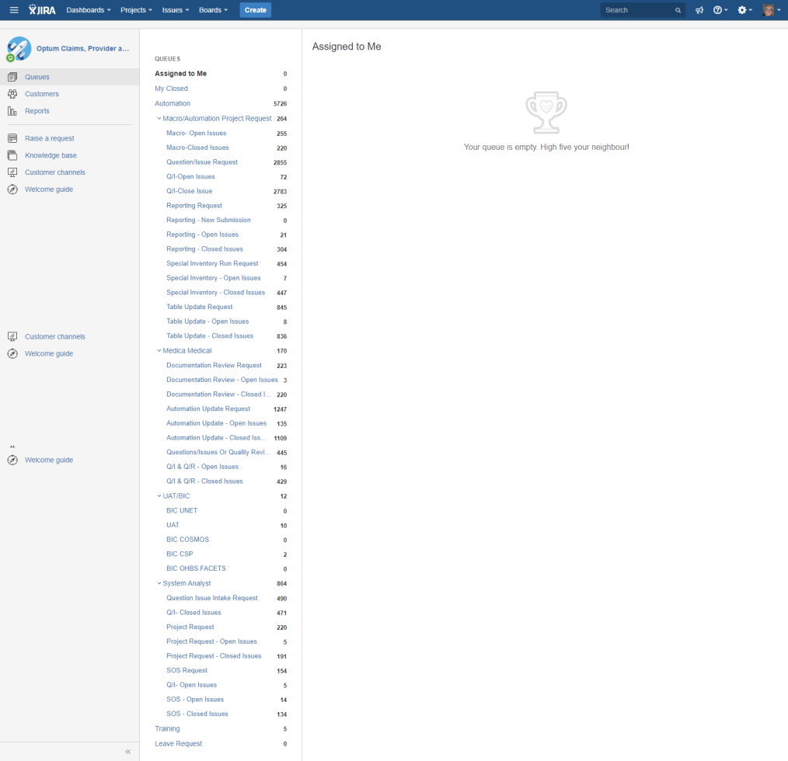
JIRA PSO Queues
https://arajira.optum.com/jira/projects/PSO/queues/custom/208
Notes:
Say: This is where you will find submitted projects and any projects assigned to you.

Slide 4
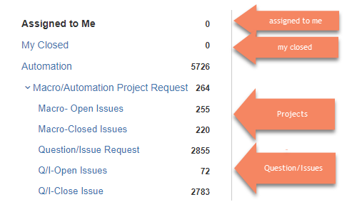
Where can I find my Projects or Question/Issues?

Slide 6
Which form should I choose?
Project Request
Question / Issue Request
Reporting Request
Special Inventory Run Request
Table Update Request
Form used to submit a Project in JIRA:
Brand new project request
To add logic to any existing program
Form used to submit a Question/Issue in JIRA:
A defect is found in existing automation
Questions about what is possible in automation
Form used to submit a Reporting Request in JIRA:
Use the Supervisor Tool and Interactive Reports that exist, only use this if current reporting capabilities do not meet your needs
Form used to submit a Special Inventory Run Request in JIRA:
Use this when directed to do so by our team
Form used to submit a Table Update Request in JIRA:
Use this when directed to do so by our team
Notes:
Review Slide
Reporting Request Links for Supervisor Tool & Interactive Tools:
Supervisor tool: http://rsreports6.uhc.com/Reports/Pages/Report.aspx?ItemPath=/Optum/OptumAA/Dashboards/SupTool+Reports/SupTools&ViewMode=Detail
Interactive Reporting: http://app29-02.optum.com/sites/ART/Automation/ClaimsAAUAT/oaa/SitePages/Home.aspx

Slide 7
Project Request

Slide 8
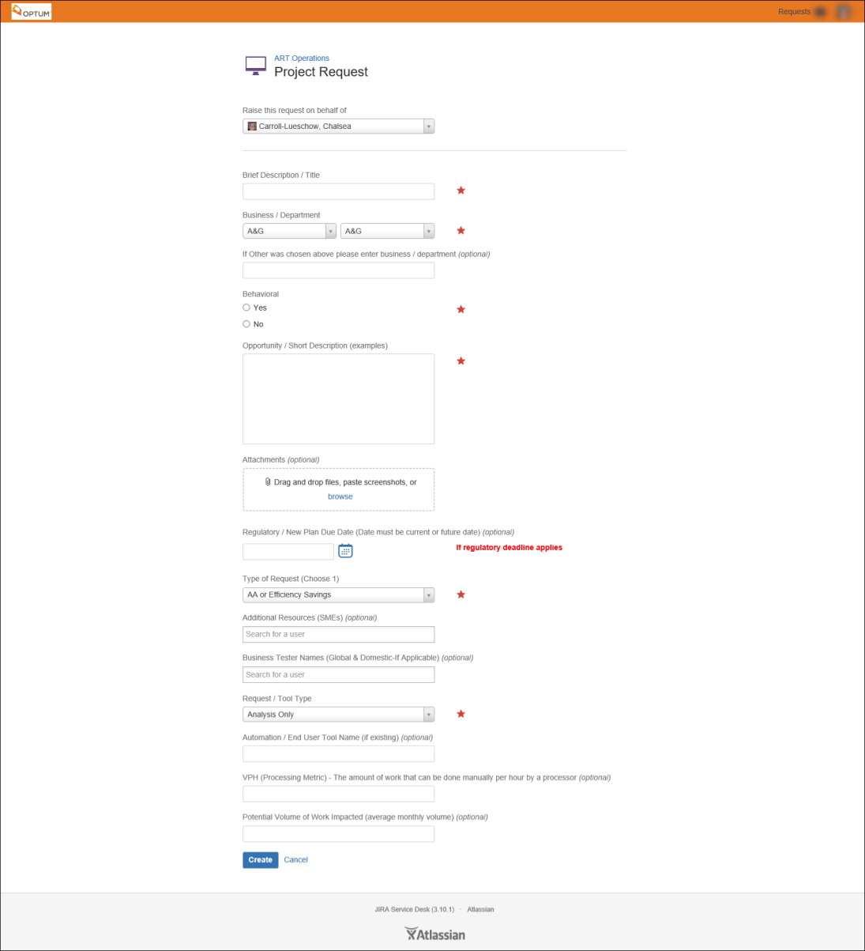
Project Request
Notes:
Say: This is what the form looks like once you choose the Project Request.
Form used to submit a Project in JIRA:
Brand new project request
To add logic to any existing program
As you can see it automatically fills in the form area: Raise this request on behalf of. We will review each area of the Project Form in the following slides.

Slide 9
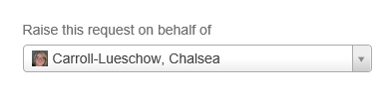
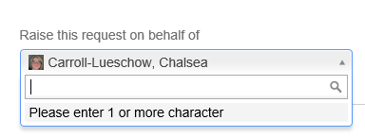
Raise this request on behalf of
Fills in your name
Can change to someone else’s name if you are submitting the request on someone else’s behalf

Slide 10
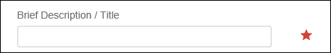
Brief Description/Title
The Red Star indicates this is a Required Field
Brief Description or Title of the Project
Notes:
Review Slide
Say: As you can see this portion of the form is very self -explanatory

Slide 11
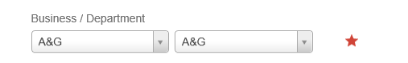
Business / Platform
Required Field (Red Star)
Department is dependent on Business chosen
Form defaults to A&G: A&G
Notes:
Review Slide
Say: None will appear as a choice under Business and Department, if choose for Business the form cannot be submitted, if chose under department it can be a choice, but as a best practice do not choose None as the Department. We will discuss each business and platform(s) in the following slides

Slide 12
Business / Departments
Business: A&G (Appeals and Grievances)
Available Departments:
A&G
Notes:
Review Slide
Say: More departments may be added as the business grows or needs change

Slide 13
Business / Departments
Business: Cash Management
Available Departments:
COSMOS
CSP Facets
DIAM
PacifiCareRIMs
RV-Facets
UNET
Notes:
Review Slide
Say: More departments may be added as the business grows or needs change

Slide 14
Business / Departments
Business: CMC
Available Departments:
COSMOS
Facets
UNET
Notes:
Review Slide
Say: More departments may be added as the business grows or needs change

Slide 15
Business / Departments
Business: Infrastructure
Available Departments:
Infrastructure
Notes:
Review Slide
Say: This is what was once referred to as Internal Logistics, this is used for internal updates

Slide 16
Business / Departments
Business: Medica Medical
Available Departments:
COSMOS B&E
COSMOS Claims
COSMOS Provider
COSMOS TA
UNET Claims
Notes:
Review Slide
Say: More departments may be added as the business grows or needs change

Slide 17
Business / Departments
Business: OBH Call
Available Departments:
Call
Notes:
Review Slide
Say: More departments may be added as the business grows or needs change

Slide 18
Business / Departments
Business: OBH Case Install
Available Departments:
Eligibility
Group
Product
Notes:
Review Slide
Say: More departments may be added as the business grows or needs change

Slide 19
Business / Departments
Business: OBH Claims
Available Departments:
BH Facets
Cirrus
Cosmos
CRT
CSP Facets
Incedo
UNET
Notes:
Review Slide
Say: More departments may be added as the business grows or needs change

Slide 20
Business / Departments
Business: OBH Clinical
Available Departments:
Clinical
Notes:
Review Slide
Say: More departments may be added as the business grows or needs change

Slide 21
Business / Departments
Business: OBH Network
Available Departments:
Network
Notes:
Review Slide
Say: More departments may be added as the business grows or needs change

Slide 22
Business / Departments
Business: OBH Provider Ops
Available Departments:
Cred
PDM
PDV
ReCred
Support Operations
Notes:
Review Slide
Say: More departments may be added as the business grows or needs change

Slide 23
Business / Departments
Business: OBH Quality (Quality Auditors Dept.)
Available Departments:
BH Facets
Cirrus
COSMOS
CSP Facets
Provider Ops
UNET
Notes:
Review Slide
Say: More departments may be added as the business grows or needs change

Slide 24
Business / Departments
Business: OptumCare
Available Departments:
Facets Mountain West Claims
Notes:
Review Slide
Say: More departments may be added as the business grows or needs change

Slide 25
Business / Departments
Business: Vendor Management
Available Departments:
Keying
Pre-Processing
RMO
Notes:
Review Slide
Say: More departments may be added as the business grows or needs change

Slide 26
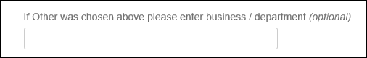
Business / Departments
Business: Other
Available Departments:
Other
Notes:
Review Slide
Say: More departments may be added as the business grows or needs change, as you can see if other is chosen above there is a space below for the appropriate business/department to be entered. Please be aware this is a last resort and you should be able to find your business/department.

Slide 27
Business/Department Best Practices
Required Field
Page defaults to A&G:A&G make sure you choose the appropriate department
None will appear as a choice under Business and Department, if chosen for Business the form cannot be submitted
As a best practice do not choose None as the Department
If Other/Other is chosen, please fill in the appropriate Business/Department in the space provided

Slide 28
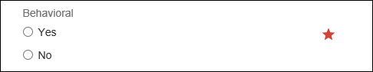
Behavioral
Is this project for Behavior Health:
Choose Yes if yes
Choose No if not

Slide 29
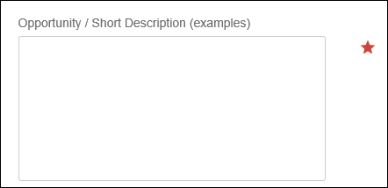
Opportunity/Description
What is the Opportunity or Description of the project
Notes:
Review Slide

Slide 30
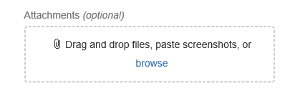
Attachments
You will have the ability to:
Drag & Drop Files
Paste Screenshots (Ctrl V)
Browse you computer and attach files
Notes:
Review Slide

Slide 31
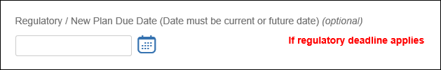
Regulatory / New Plan Due Date
This field is only for legal compliance or new plan implementation
This will be validated
Otherwise project will go through regular prioritization

Slide 32
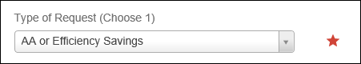
Type of Request
Defaults to AA or Efficiency Savings
Types Include:
AA or Efficiency Savings
Affordability Initiative
Automation Error Response
BAR
External Client (i.e. Medica)
Policy & Procedure Change
Quality Improvements
Regulatory/Compliance (i.e. CMS, State Request)
System Release/Reconfiguration

Slide 33
Type of Request
Definitions
AA or Efficiency Savings | Project related to increasing the Auto Adjudication (AA) rate and or building efficiency in the process (I.e. end user tools, FTE reduction)
Affordability Initiative | Project driven by the Affordability team; initiatives are typically related to a policy change, that will change the payout to providers or facilities. The changes result in benefit to the company (i.e. OON Reimbursement Initiative).
Automation Error Response | Response to an error found within current automations/end-user tools
BAR | BAR (Benefits and Administrative Review) requests are requested exceptions to standard policies for new /renewal of business. Currently they apply to Cirrus, COSMOS and UNET, but BH Facets and CSP Facets will be added down the road.
External Client (i.e. Medica) | Project submitted by organization outside of Optum
Policy & Procedure Change | Project related to a Policy and Procedure change initiated by the business
Quality Improvements | Project that supports a quality improvement to an existing process that may not have an AA (auto adjudication) or building efficiency
Regulatory Compliance (i.e.. CMS, State Request) | Project related to a regulatory or compliance initiative or change
System Release/Reconfiguration | Project related to a system enhancement or configuration change not related to AA or building efficiency

Slide 34
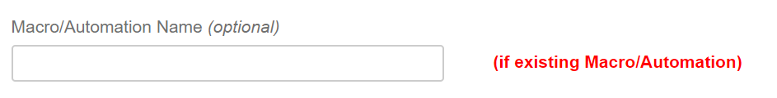
Macro/Automation Name
Optional
Macro or Automation name if existing
Notes:
Review Slide

Slide 35
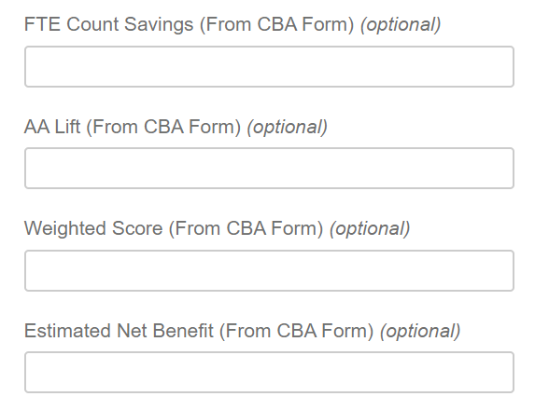
CBA Information
Optional
Information from CBA on:
FTE Count Savings
AA Lift
Weighted Score
Estimated Net Benefit
Notes:
Review Slide

Slide 36
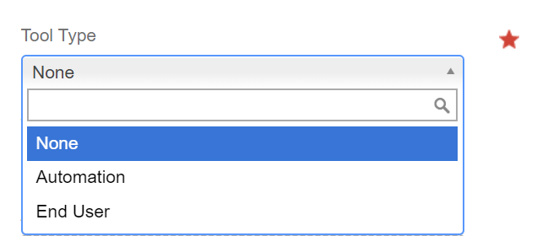
Tool Type
Required (Red Star)
None
Automation
End User
Notes:
Review Slide

Slide 37
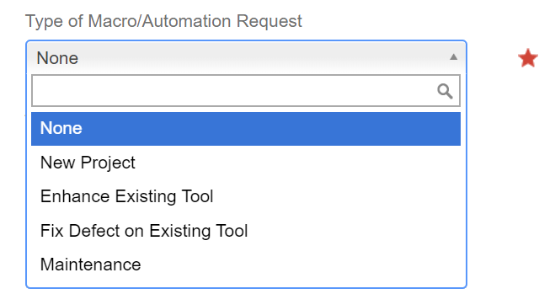
Type of Macro/Automation Request
Required (Red Star)
New Project
Enhance Existing Tool
Fix Defect in Existing Tool
Maintenance
Notes:
Review Slide

Slide 38
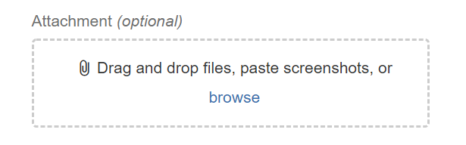
Attachment
Optional
Drag and Drop Files
Paste Screenshots
Browse and attach

Slide 39
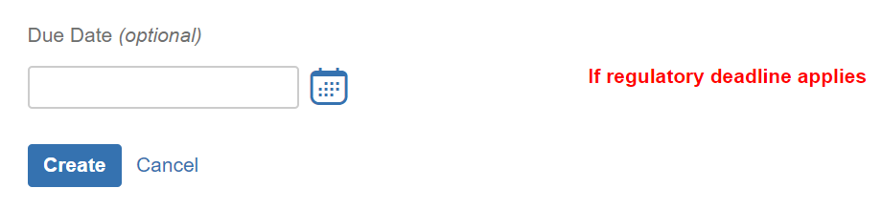
Due Date
Optional
Only to be used if regulatory deadline applies
Notes:
Review Slide
Say: Once all the fields have been completed then click CREATE, by entering the data through the Customer Portal we ensure all required fields have been completed. Any questions on the Project Request Form?

Slide 40
Question / Issue Request
Notes:
Now we will cover the Question/Issue Request Form, you will see many similarities between the 2 forms.

Slide 41
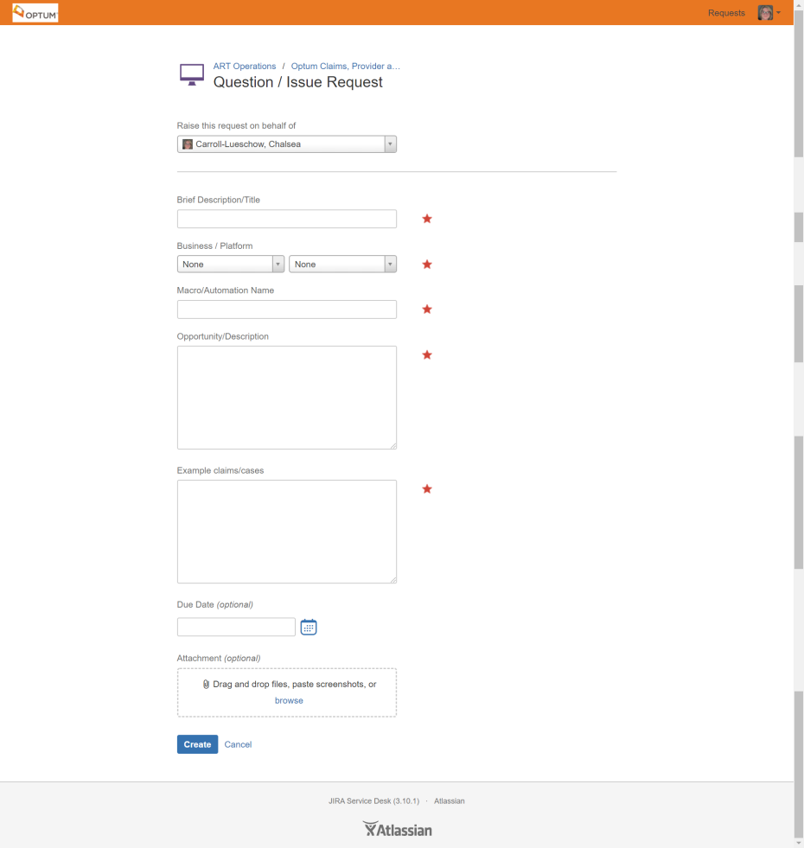
Question / Issue Request
Notes:
Say: This is what the form looks like once you choose the Question / Issue Request. As you can see it automatically fills in the form area: Raise this request on behalf of.

Slide 42
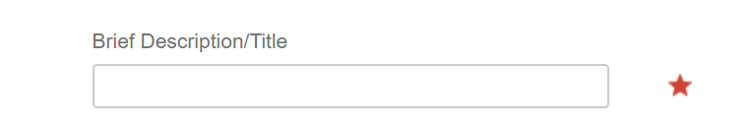
Brief Description/Title
Required Field
Brief Description or Title of the Project
Notes:
Review Slide

Slide 43
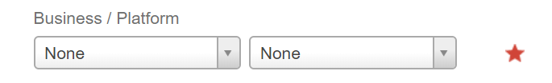
Business / Platform
Required Field
Platform is dependent on business chosen
Notes:
Review Slide
Say: We will discuss each business and platform in the following slides

Slide 44
Business / Platform
Behavioral Health
Notes:
Review Slide

Slide 45
Business / Platform
Prov OPS
Notes:
Review Slide

Slide 46
Business / Platform
OptumCare
Notes:
Review Slide

Slide 47
Business / Platform
Physical Health
Notes:
Review Slide

Slide 48
Business / Platform
CMC
Notes:
Review Slide

Slide 49
Business / Platform
Cash Management
Notes:
Review Slide

Slide 50
Business / Platform
CRT
Notes:
Review Slide

Slide 51
Business / Platform
Vendor Management
Notes:
Review Slide

Slide 52
Business / Platform
A&G
Notes:
Review Slide

Slide 53
Business / Platform
Innovation
Notes:
Review Slide

Slide 54
Business / Platform
Internal Logistics
Notes:
Review Slide

Slide 55
Business / Platform
Other
Notes:
Review Slide

Slide 56
Business / Platform
Financial Services

Slide 57
Business / Platform
OHBS Quality (Quality Auditors Dept)

Slide 58
Business / Platform
Financial Services
Notes:
Review Slide

Slide 59
Business / Platform
OHBS Quality (Quality Auditors Dept)
Notes:
Review Slide

Slide 60
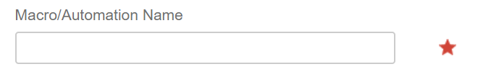
Macro/Automation Name
Required Field
The Macro or Automation Name

Slide 61
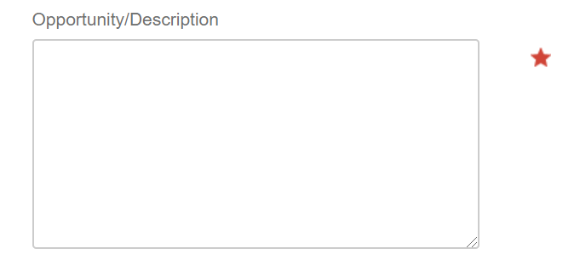
Opportunity/Description
Required Field
What is the Opportunity or Description of the project

Slide 62
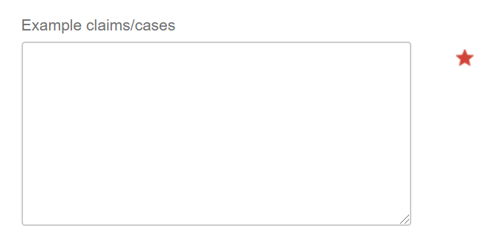
Example Claims/Cases
Required
Examples of the claims or cases leading to the Question or Issue

Slide 63
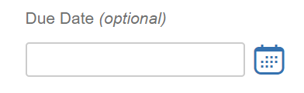
Due Date
Optional Field
When due

Slide 64
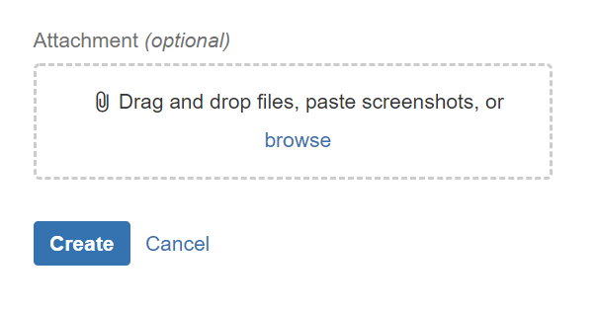
Attachment
Optional
Drag and Drop Files
Paste Screenshots
Browse and attach
Notes:
Review Slide
Say: Once all the fields have been completed then click CREATE

Slide 65
Reporting Request

Slide 66
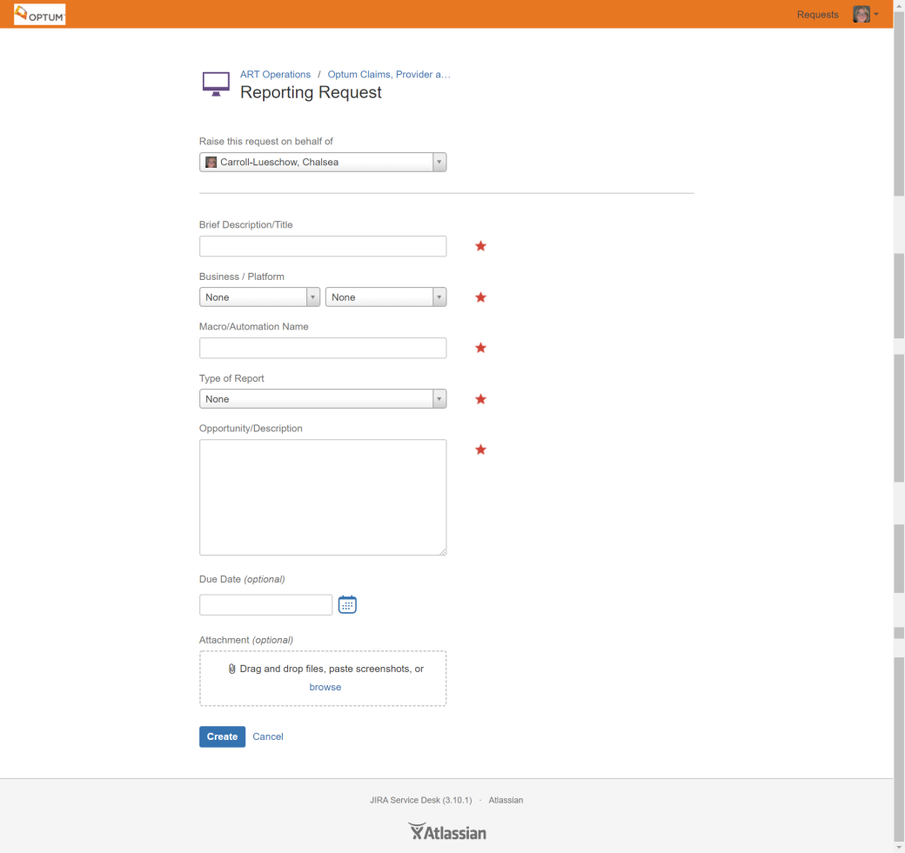
Reporting Request
Notes:
Say: This is what the form looks like once you choose the Reporting Request. As you can see it automatically fills in the form area: Raise this request on behalf of.
Links for Supervisor Tool & Interactive Tools:
Supervisor tool: http://rsreports6.uhc.com/Reports/Pages/Report.aspx?ItemPath=/Optum/OptumAA/Dashboards/SupTool+Reports/SupTools&ViewMode=Detail
Interactive Reporting: http://app29-02.optum.com/sites/ART/Automation/ClaimsAAUAT/oaa/SitePages/Home.aspx

Slide 67
Brief Description/Title
Required Field
Brief Description or Title of the Project
Notes:
Review Slide

Slide 68
Business / Platform
Required Field
Platform is dependent on business chosen
Notes:
Review Slide
Say: We will discuss each business and platform in the following slides

Slide 69
Business / Platform
Behavioral Health
Notes:
Review Slide

Slide 70
Business / Platform
Prov OPS
Notes:
Review Slide

Slide 71
Business / Platform
OptumCare
Notes:
Review Slide

Slide 72
Business / Platform
Physical Health
Notes:
Review Slide

Slide 73
Business / Platform
CMC
Notes:
Review Slide

Slide 74
Business / Platform
Cash Management
Notes:
Review Slide

Slide 75
Business / Platform
CRT
Notes:
Review Slide

Slide 76
Business / Platform
Vendor Management
Notes:
Review Slide

Slide 77
Business / Platform
A&G
Notes:
Review Slide

Slide 78
Business / Platform
Innovation
Notes:
Review Slide

Slide 79
Business / Platform
Internal Logistics
Notes:
Review Slide

Slide 80
Business / Platform
Other
Notes:
Review Slide

Slide 81
Business / Platform
Financial Services

Slide 82
Business / Platform
OHBS Quality (Quality Auditors Dept)

Slide 83
Macro/Automation Name
Required Field
The Macro or Automation Name

Slide 84
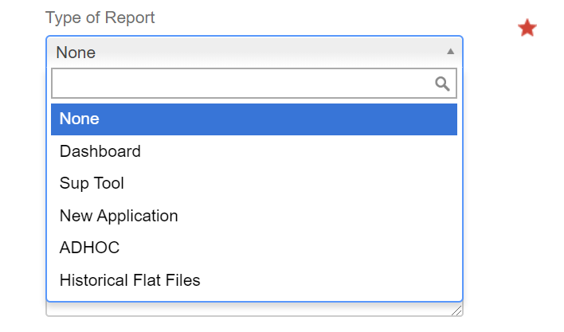
Type of Report
Required
Dashboard
Sup Tool
New Application
ADHOC
Historical Flat Files
Notes:
NEED DEFINTIONS

Slide 85
Opportunity/Description
Required Field
What is the Opportunity or Description of the project

Slide 86
Due Date
Optional Field
When due

Slide 87
Attachment
Optional
Drag and Drop Files
Paste Screenshots
Browse and attach
Notes:
Review Slide
Say: Once all the fields have been completed then click CREATE

Slide 88
Special Inventory Run Request

Slide 89
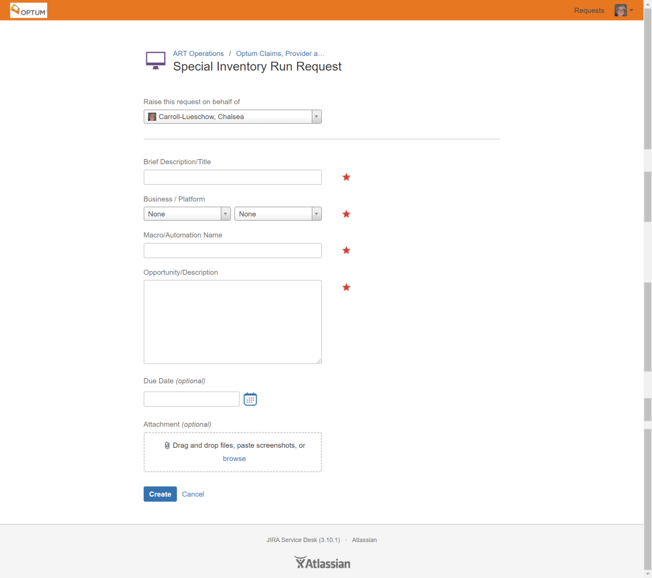
Special Inventory Run Request
Notes:
Say: This is what the form looks like once you choose the Special Inventory Run Request. As you can see it automatically fills in the form area: Raise this request on behalf of.

Slide 90
Brief Description/Title
Required Field
Brief Description or Title of the Project
Notes:
Review Slide

Slide 91
Business / Platform
Required Field
Platform is dependent on business choose
Notes:
Review Slide
Say: We will discuss each business and platform in the following slides

Slide 92
Business / Platform
Behavioral Health
Notes:
Review Slide

Slide 93
Business / Platform
Prov OPS
Notes:
Review Slide

Slide 94
Business / Platform
OptumCare
Notes:
Review Slide

Slide 95
Business / Platform
Physical Health
Notes:
Review Slide

Slide 96
Business / Platform
CMC
Notes:
Review Slide

Slide 97
Business / Platform
Cash Management
Notes:
Review Slide

Slide 98
Business / Platform
CRT
Notes:
Review Slide

Slide 99
Business / Platform
Vendor Management
Notes:
Review Slide

Slide 100
Business / Platform
A&G
Notes:
Review Slide

Slide 101
Business / Platform
Innovation
Notes:
Review Slide

Slide 102
Business / Platform
Internal Logistics
Notes:
Review Slide

Slide 103
Business / Platform
Other
Notes:
Review Slide

Slide 104
Business / Platform
Financial Services

Slide 105
Business / Platform
OHBS Quality (Quality Auditors Dept)

Slide 106
Macro/Automation Name
Required Field
Macro or Automation Name

Slide 107
Opportunity/Description
Required Field
What is the Opportunity or Description of the project

Slide 108
Due Date
Optional Field
When due

Slide 109
Attachment
Optional
Drag and Drop Files
Paste Screenshots
Browse and attach
Notes:
Review Slide
Say: Once all the fields have been completed then click CREATE

Slide 110
Table Update Request

Slide 111
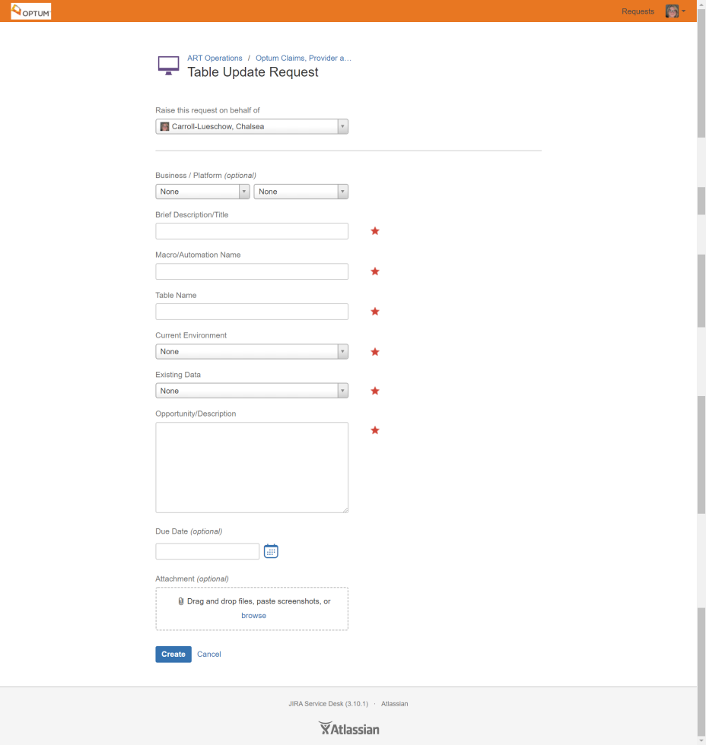
Table Update Request
Notes:
Say: This is what the form looks like once you choose the Table Update Request. As you can see it automatically fills in the form area: Raise this request on behalf of.

Slide 112
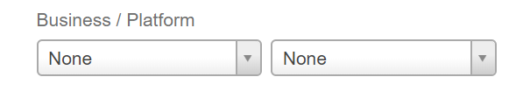
Business / Platform
Optional Field
Platform is dependent on business choosen
Notes:
Review Slide
Say: We will discuss each business and platform in the following slides

Slide 113
Business / Platform
Behavioral Health
Notes:
Review Slide

Slide 114
Business / Platform
Prov OPS
Notes:
Review Slide

Slide 115
Business / Platform
OptumCare
Notes:
Review Slide

Slide 116
Business / Platform
Physical Health
Notes:
Review Slide

Slide 117
Business / Platform
CMC
Notes:
Review Slide

Slide 118
Business / Platform
Cash Management
Notes:
Review Slide

Slide 119
Business / Platform
CRT
Notes:
Review Slide

Slide 120
Business / Platform
Vendor Management
Notes:
Review Slide

Slide 121
Business / Platform
A&G
Notes:
Review Slide

Slide 122
Business / Platform
Innovation
Notes:
Review Slide

Slide 123
Business / Platform
Internal Logistics
Notes:
Review Slide

Slide 124
Business / Platform
Other
Notes:
Review Slide

Slide 125
Business / Platform
Financial Services

Slide 126
Business / Platform
OHBS Quality (Quality Auditors Dept)

Slide 127
Brief Description/Title
Required Field
Brief Description or Title of the Project
Notes:
Review Slide

Slide 128
Macro/Automation Name
Required Field
Macro or Automation Name

Slide 129
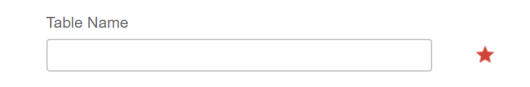
Table Name
Required
Name of Table

Slide 130
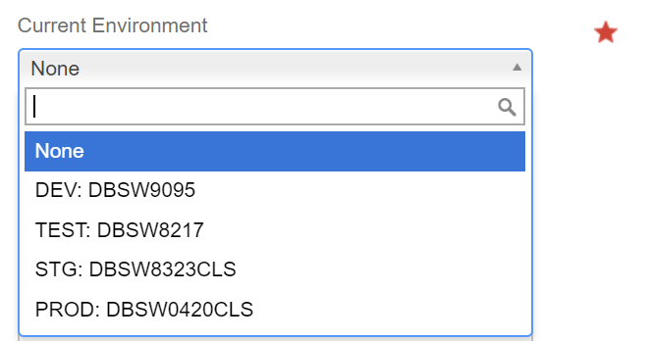
Current Environment
Required
None
DEV
TEST
STG
PROD

Slide 131
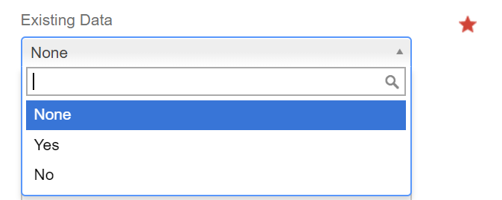
Existing Data
Required Field
None
Yes
No

Slide 132
Opportunity/Description
Required Field
What is the Opportunity or Description of the project

Slide 133
Due Date
Optional Field
When due

Slide 134
Attachment
Optional
Drag and Drop Files
Paste Screenshots
Browse and attach
Notes:
Review Slide
Say: Once all the fields have been completed then click CREATE

Slide 135

Questions

Slide 136
Thank you.

